Slide 1
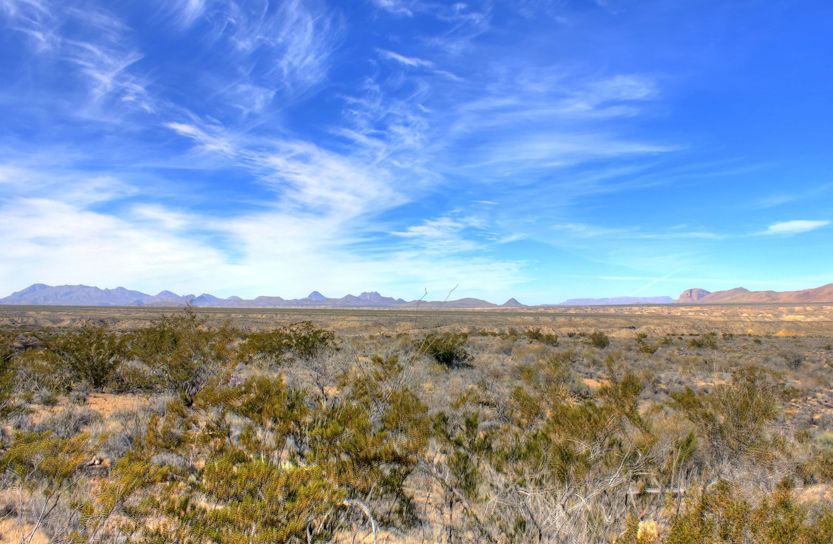




Designing for Fire Resilience:
Trees, Defensible Space, and
the Built Environment
TFSWEB.TAMU.EDU

Slide 2
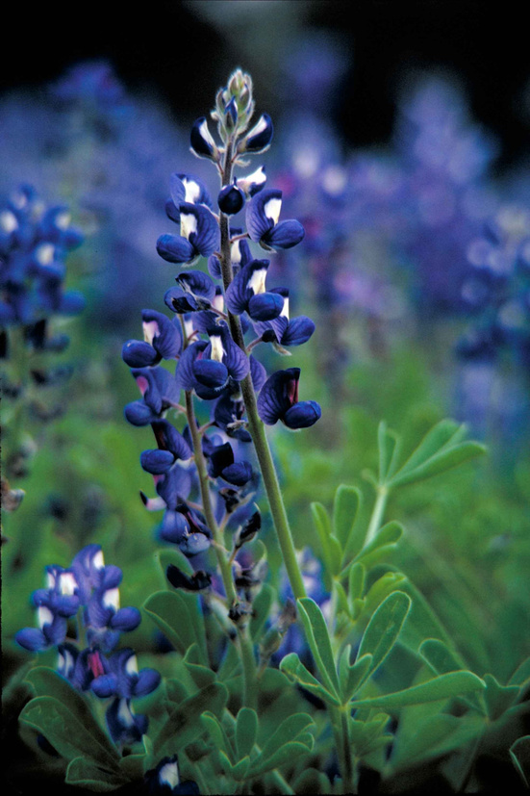
Course Objectives
1. Understand wildfire behavior and how it moves in the landscape
2. Evaluate landscape through an arborist’s view and emphasize the importance of vegetation maintenance
3. Apply defensible-space principles through design

Slide 3
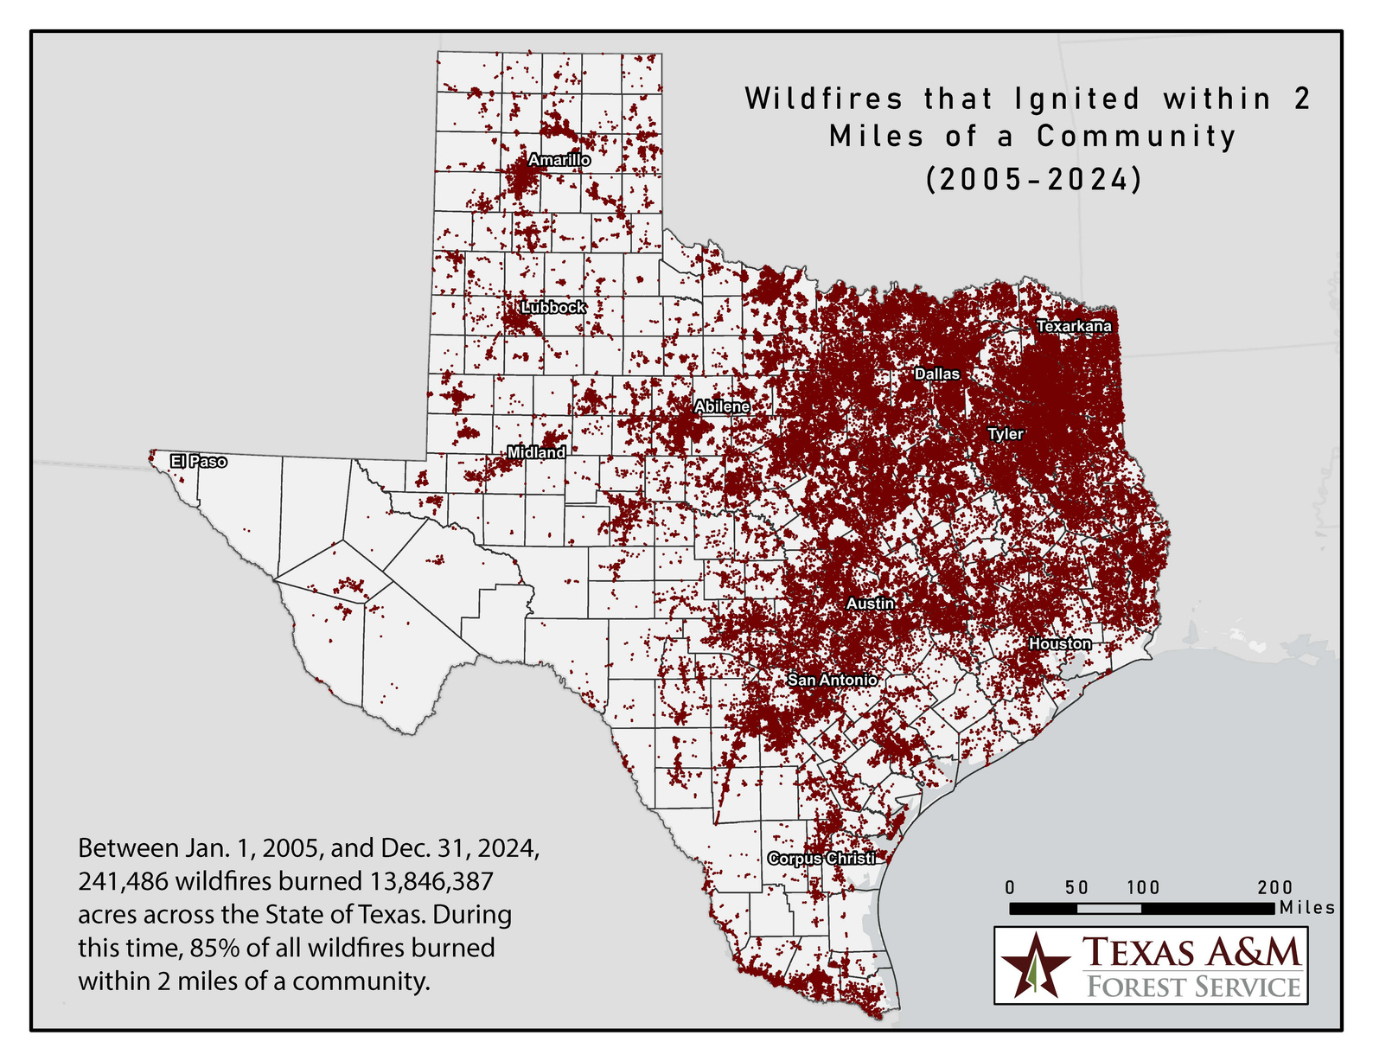
WHY THIS MATTERS
Wildfire is a design issue, not just a wildland issue
Notes:
Quick poll in the chat, what does wildfire mean to you as an arborist?

Slide 4
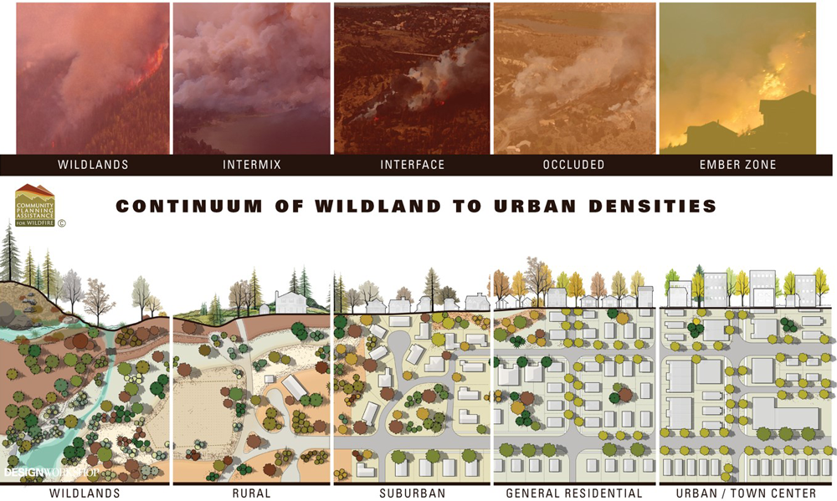
Notes:
POLL: How often do wildfire concerns influence your projects?
FOCUS: wildfires can impact areas of a community that are not adjacent to 'wildlands'.
All of these areas from wildland to urban, have trees and vegetation, just at varying levels.
"Before we can design for resilience, we need to understand how fire actually behaves."

Slide 5
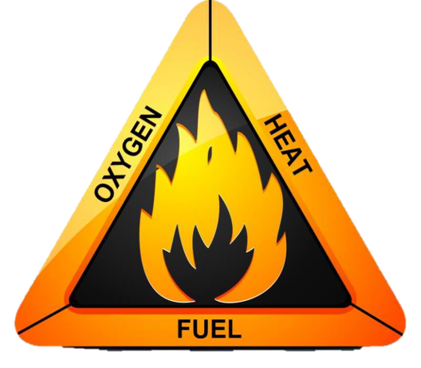
FIRE SCIENCE
Three elements must be present and combined before combustion can occur or continue
  Oxygen: Ambient air contains 21% oxygen.
  Fuel: Source of combustible gas, liquid or solid must be present
  Heat Source: Must be present
Notes:
May seem rudimentary, but we want to get the science down and connect it later on.
FOCUS:
We can control the fuel and heat side of the fire triangle.

Slide 6
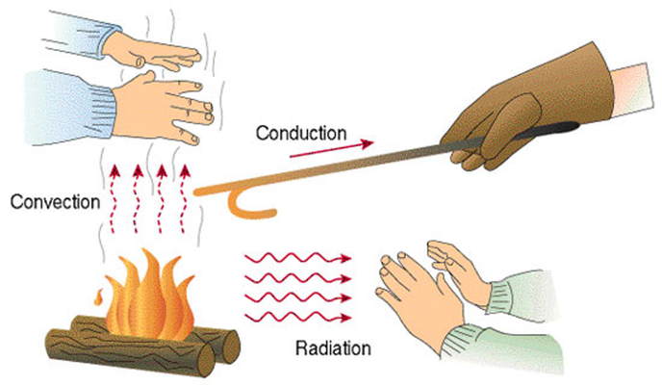
HOW FIRE MOVES THROUGH THE LANDSCAPE
  Radiation
    Heat dries surrounding fuels and can ignite them
  Convection
    Hot air preheating what is above it. Dries taller fuels and can ignite them
  Conduction
    Heat moving from one fuel particle to another through direct contact
Notes:
Fire Movement - Heat transfer
FOCUS: Not all fire/heat transfer is done through direct contact with flames.

Slide 7
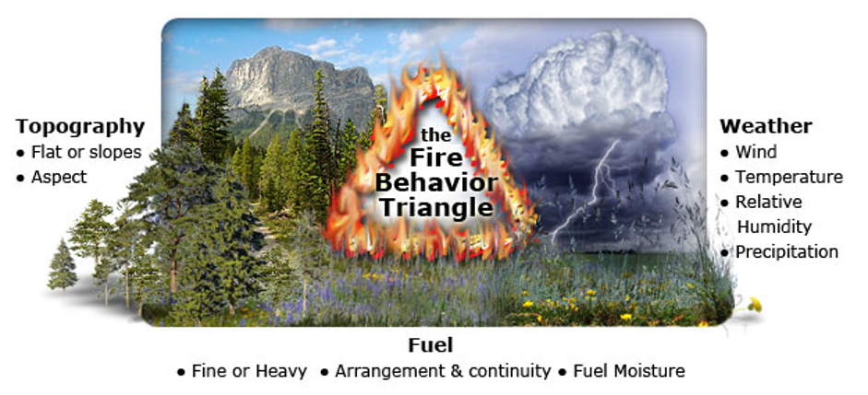
HOW FIRE MOVES THROUGH THE LANDSCAPE
Notes:
Take away any one of the legs of the triangle, lower the intensity of a fire.
Will not discuss fire beahvior and intensity other than this: In wildfire mitigation view, we are trying to lower fire intensity as it relates to ecosystems and communities.
FOCUS: Fuels are something that can be planned for and controlled to reduce wildfire risks.

Slide 8

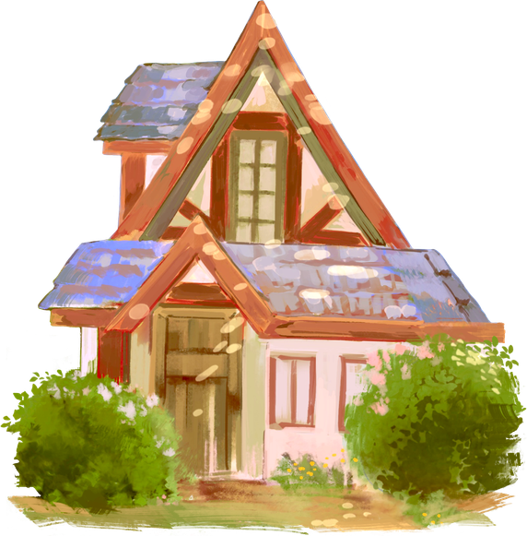
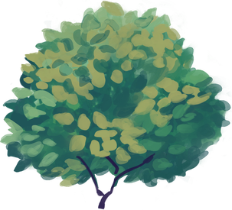



HOW FIRE MOVES THROUGH THE LANDSCAPE
  Surface Fires
  Ember Driven Ignitions
Ground → Shrubs → Lower Branches → Canopy → Structure
Notes:
COVER:
Surface Fires - fire close to ground, low growing vegetation (grass, shrub dominated).
DIFFERENCE IN FINE vs COARSE FUELS. (fine includes grass, pine needles) (coarse includes larger sticks/twigs/ limbs)
CAMP FIRE ANALOGY
Ember driven ignitions - Fires put off small pieces of burning material that can cause fires further on in a landscape.
FOCUS: Design decisions influence whether fire remains on the ground or reaches structures

Slide 9
HOW FIRE MOVES THROUGH THE LANDSCAPE
  Ladder Fuels
  Crown Fire
Horizontal movement → Vertical Movement
Notes:
Ladder Fuels
Crown fire
FOCUS: Reducing vertical and horizontal fuel continuity rather than attempting to eliminate all vegetation.

Slide 10
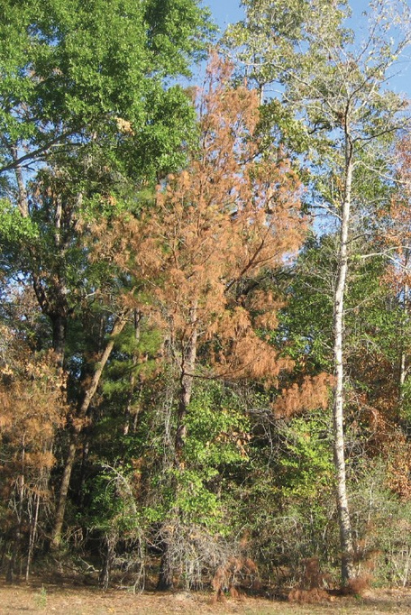
WHAT ARE LADDER FUELS?
  Live or dead fuel that provides vertical continuity from surface to canopy

Slide 11
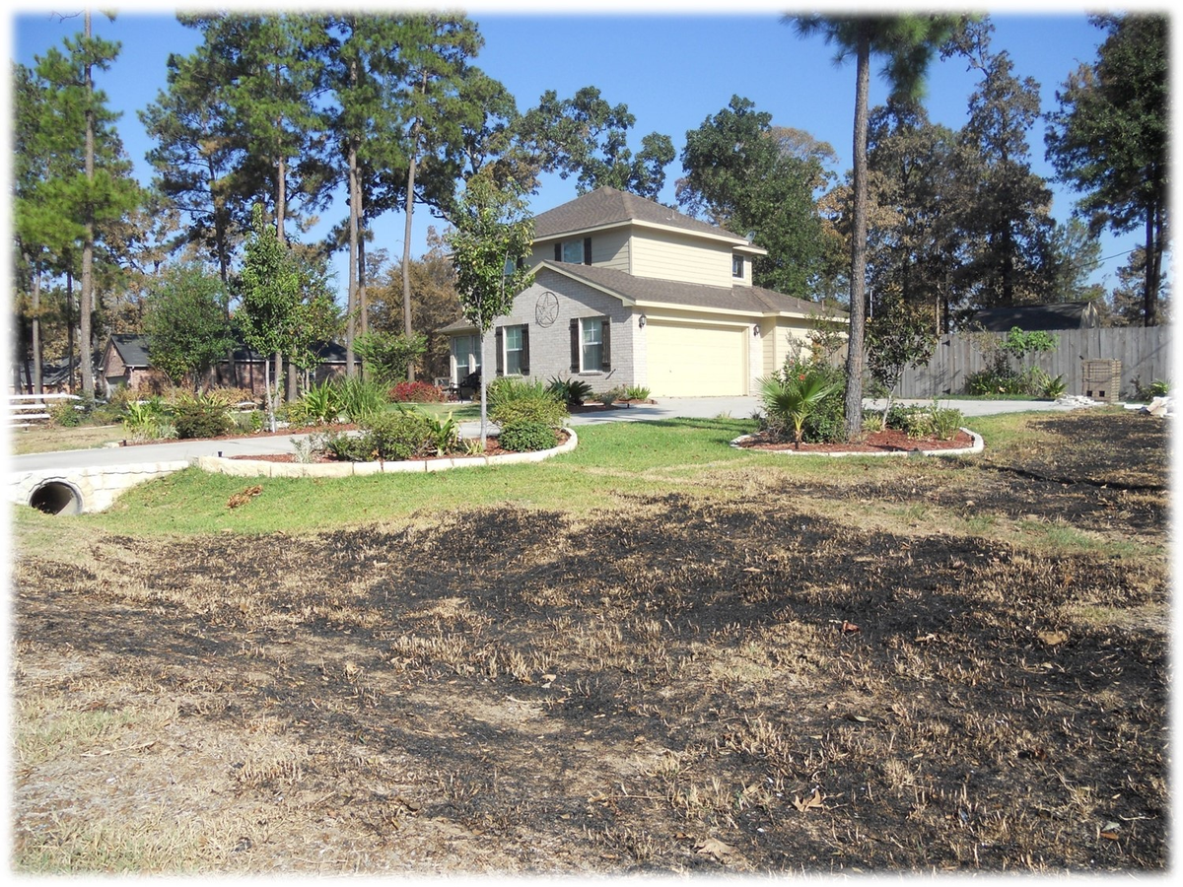
RISK VS
FIRE RESILIENCE
Goal: Healthy trees in the right place
Notes:
Benefits of Trees
• Shade and cooling
• Carbon storage
• Stormwater management
Fire Hazards
• Dead material
• Dense canopies
• Low branches
• Poor species selection
• Overhanging structures
How Certified Arborists evaluate:
• Tree condition
• Fuel characteristics
• Fuel continuity
- Tree placement

Slide 12
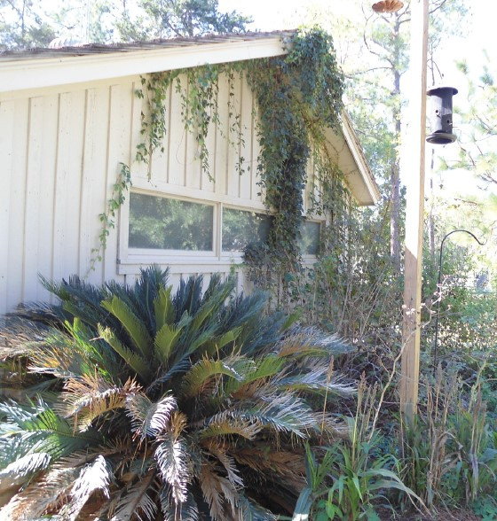
RISK MANAGEMENT
SCENARIOS
Notes:
What hazards do we see in this photo?
Vines in the eaves
Cycad not healthy?
fine fuels right next to the home.

Slide 13
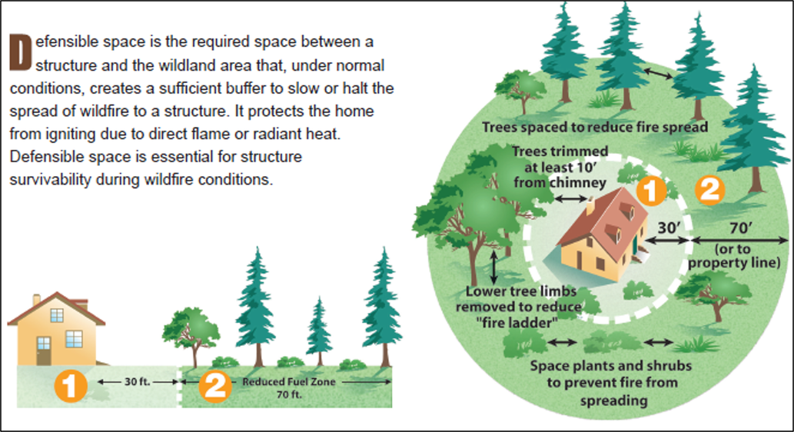
DEFENSIBLE SPACE VS DESIGN
Notes:
FOCUS: Defensible space is about modifying fire behavior—not removing all vegetation.
Structure
Zone 1
Lean, clean, and green
Zone 2
Fuel reduction and management

Slide 14
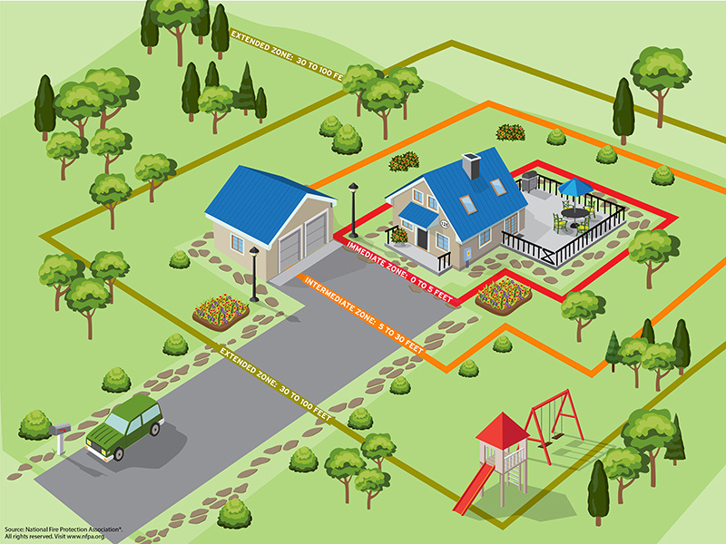
STRUCTURE IGNITION ZONES
Notes:
FOCUS: Defensible space is about modifying fire behavior not removing all vegetation.
Structure
Focusing on structure first, then areas around it.
Design principles are as follows:
Separate
Reduce fuel continuity
Interrupt
Break pathways for fire spread
Maintain
Plan for long-term management
MUCH easier to do work prior to building or in planning stage than to retrofit afterwards.

Slide 15
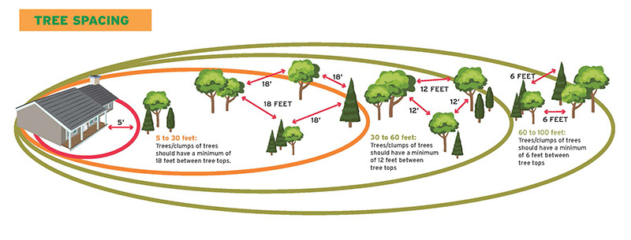
STRUCTURE IGNITION ZONES
Notes:
FOCUS: Defensible space is about modifying fire behavior not removing all vegetation.
Structure
Focusing on structure first, then areas around it.
Design principles are as follows:
Separate
Reduce fuel continuity
Interrupt
Break pathways for fire spread
Maintain
Plan for long-term management
MUCH easier to do work prior to building or in planning stage than to retrofit afterwards.

Slide 16
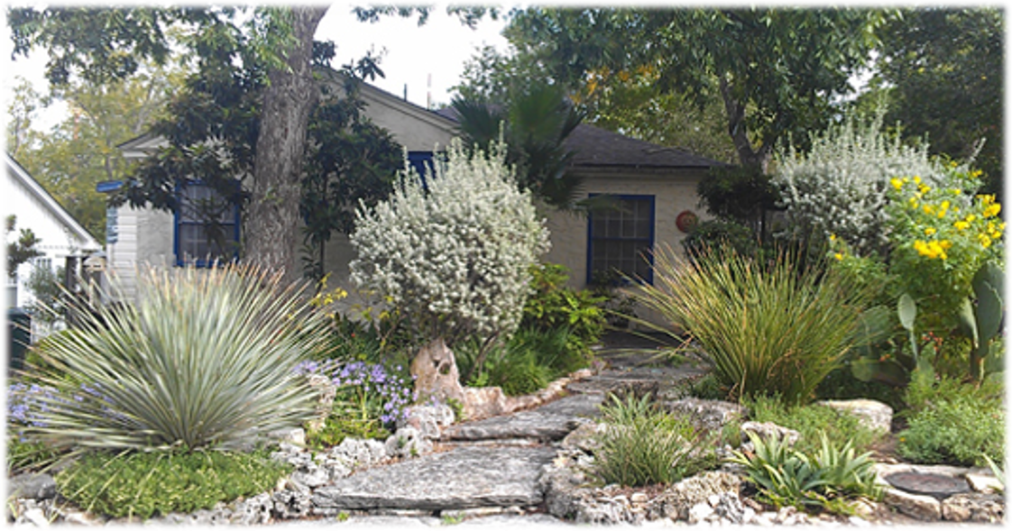
RISK MANAGEMENT SCENARIOS

Slide 17
SPECIES SELECTION GENERALIZATIONS
ALL VEGETATION IS POTENTIAL FUEL
FOR A WILDFIRE
FIRE RESISTANT PLANTS
  NATIVE, HEALTHY
  Higher moisture content
  Drought tolerant
  Open, loose branching
  Low growing
  Easy to maintain and prune
  Little accumulation of dead materials
FIRE RESISTANT TREES
  NATIVE, HEALTHY
  Higher moisture content
  Drought tolerant
  Low resin/oil
  Self-pruning
  Minimal leaf litter/fine fuels
Notes:
Resilience starts with appropriate tree selection and maintenance.
Species Selection Factors
• Moisture content
• Branching structure
• Bark characteristics
• Maintenance requirements
Pruning Best Practices
• Reduce ladder fuels
• Remove deadwood
• Maintain appropriate canopy spacing
Proper Maintenance Principles

Slide 18
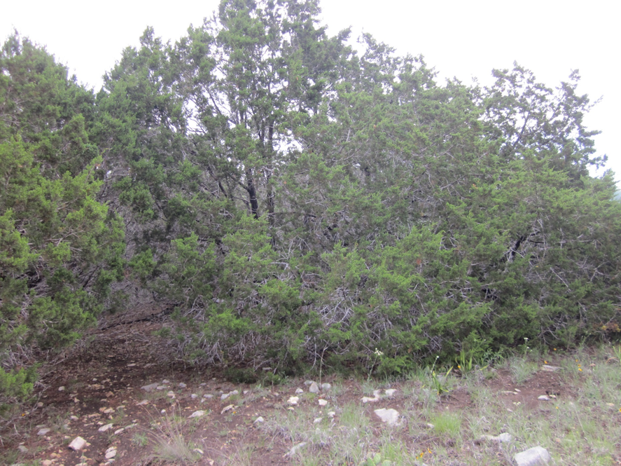
LANDSCAPE LEVEL TREATMENTS
Notes:
Resilience starts with appropriate tree selection and maintenance.
Species Selection Factors
• Moisture content
• Branching structure
• Bark characteristics
• Maintenance requirements
Pruning Best Practices
• Reduce ladder fuels
• Remove deadwood
• Maintain appropriate canopy spacing
Preservation Principles
• Avoid over-thinning
• Retain healthy mature trees
• Protect ecosystem services

Slide 19
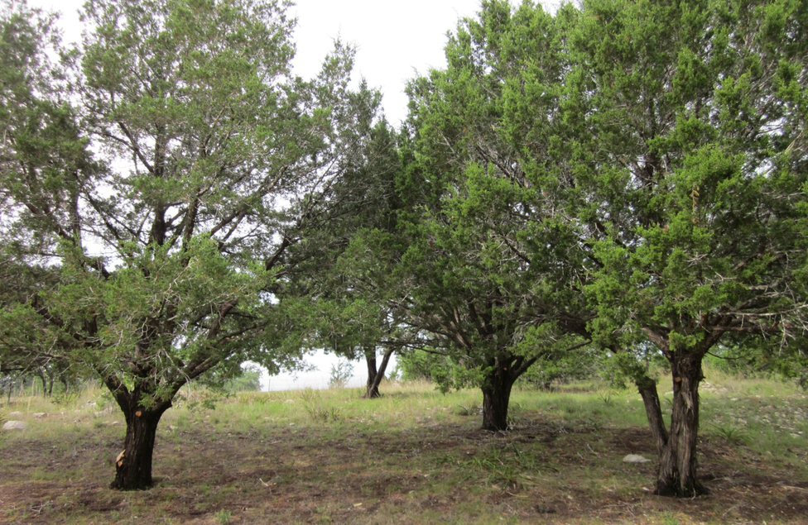
LANDSCAPE LEVEL TREATMENTS
Notes:
Resilience starts with appropriate tree selection and maintenance.
Species Selection Factors
• Moisture content
• Branching structure
• Bark characteristics
• Maintenance requirements
Pruning Best Practices
• Reduce ladder fuels
• Remove deadwood
• Maintain appropriate canopy spacing
Preservation Principles
• Avoid over-thinning
• Retain healthy mature trees
• Protect ecosystem services

Slide 20
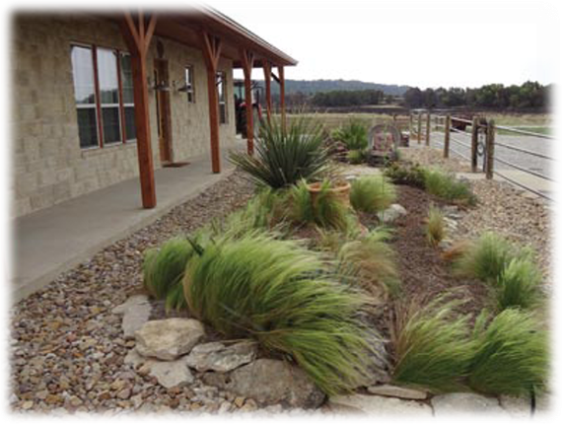
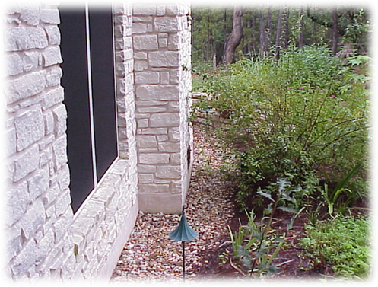
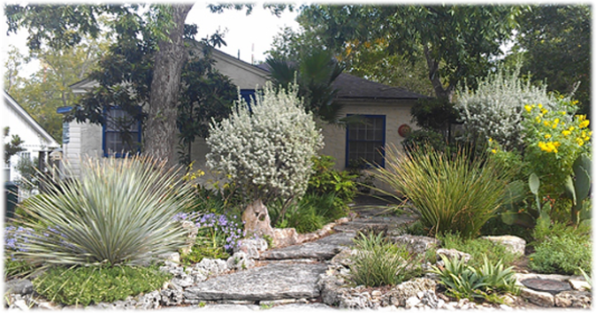
STRUCTURE LEVEL TREATMENTS
Notes:
Resilience starts with appropriate tree selection and maintenance.
Species Selection Factors
• Moisture content
• Branching structure
• Bark characteristics
• Maintenance requirements
Pruning Best Practices
• Reduce ladder fuels
• Remove deadwood
• Maintain appropriate canopy spacing
Preservation Principles
• Avoid over-thinning
• Retain healthy mature trees
• Protect ecosystem services

Slide 21
STRUCTURE LEVEL TREATMENTS
Notes:
Resilience starts with appropriate tree selection and maintenance.
Species Selection Factors
• Moisture content
• Branching structure
• Bark characteristics
• Maintenance requirements
Pruning Best Practices
• Reduce ladder fuels
• Remove deadwood
• Maintain appropriate canopy spacing
Preservation Principles
• Avoid over-thinning
• Retain healthy mature trees
• Protect ecosystem services

Slide 22
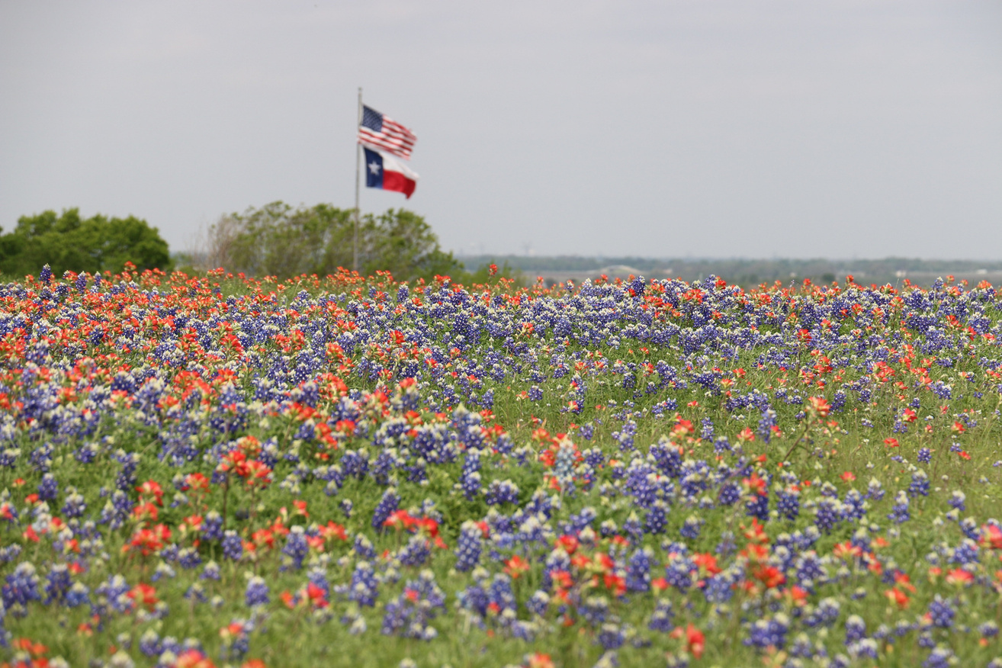


CONSERVE. PROTECT. LEAD.
TFSWEB.TAMU.EDU
Questions & Answers
Alex Bregenzer
Program Specialist
Fire Adapted Communities
alex.bregenzer@tfs.tamu.edu
Notes:
Three Things to Remember
- Trees are part of the solution when properly managed.
- Defensible space is a design opportunity, not just a compliance requirement.
- Landscape architects and Certified Arborists are critical partners in creating fire-adapted communities.
ISA Texas puts on a Wildfire Risk Reduction Qualification Course for Arborists.

Slide 23

CONSERVE. PROTECT. LEAD.
TFSWEB.TAMU.EDU

